Slide 1
William Stallings
Computer Organization and Architecture
9th Edition
Chapters 4, 5, 6
Memory

Slide 2
Key Characteristics of Memory Systems
Location
Capacity
Unit of transfer
Access method
Performance
Physical type
Physical characteristics
Organization

Slide 3
Location
Internal or external to computer
Internal
  Usually main memory
  May also be cache
  In CPU
    registers
External
  Peripheral storage devices accessible to processor via I/O controllers

Slide 4
Capacity
Could refer to two things
  Size of storage cell
  Number of storage cells
Word size
  The natural unit of organization
  Common word lengths are 8, 16, 32
    12, 24, 36, 64 have also been used
Number storage cells
  Usually expressed in bytes
  But may be in words

Slide 5
Unit of Transfer
Internal
  Usually governed by data bus width
External
  Usually a block which is much larger than a word
Addressable unit
  Smallest location which can be uniquely addressed
  Byte or word internally
  Cluster on hard drives

Slide 6
Access Methods (1)
Sequential
  Start at the beginning and read through in order
  Data organized into records
  Access time depends on location of data and previous location
  e.g. tape
Direct
  Individual blocks have unique address
  Access is by jumping to vicinity plus sequential search
  Access time depends on location and previous location
  e.g. disk

Slide 7
Access Methods (2)
Random
  Individual addresses identify locations exactly
  Access time is independent of location or previous access
  e.g. RAM
Associative
  Data is located by a comparison with portion of contents
  Access time is independent of location or previous access
  e.g. cache

Slide 8
Performance Parameters
Access time
  Time between presenting the address and getting the valid data
Memory Cycle time
  Time may be required for the memory to “recover” before next access
  Cycle time is access + recovery
Transfer Rate
  Rate at which data can be moved
    For RAM equal to 1/(cycle time)
    For others equal to
    avg access time + #bits/transfer rate in bps

Slide 9
Physical Types
Semiconductor
  RAM
Magnetic
  Disk & Tape
Optical
  CD & DVD
Magneto-optical
  Expensive and slow

Slide 10
Physical Characteristics of Data Storage
Decay
Volatility
Erasable
Power consumption

Slide 11
Memory Hierarchy
Design constraints
  How much, how fast, how expensive
Trade-off between capacity, access time, and cost
  Faster access ➔ greater cost per bit
  Greater capacity ➔ smaller cost per bit
  Greater capacity ➔ slower access time
Need to employ a memory hierarchy

Slide 12
Memory Hierarchy
Registers
  In CPU
Internal or Main memory
  May include one or more levels of cache
  “RAM”
External memory
  Backing store

Slide 13
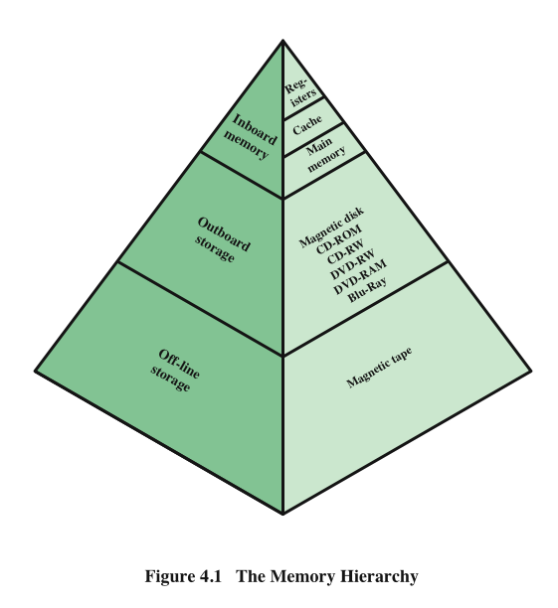
Memory Hierarchy - Diagram

Slide 14
Hierarchy List
Registers
Onboard Cache
Offboard Cache
Main memory
Disk cache
Disk
Optical
Tape
Going down the hierarchy
  Decreasing cost/bit vs increasing capacity
  Increasing access time vs decreasing frequency of access

Slide 15
Organization – another key design issue
Physical arrangement of bits into words
Not always obvious
  e.g. interleaved

Slide 16
William Stallings
Computer Organization and Architecture
9th Edition
Chapter 5
Internal Memory

Slide 17
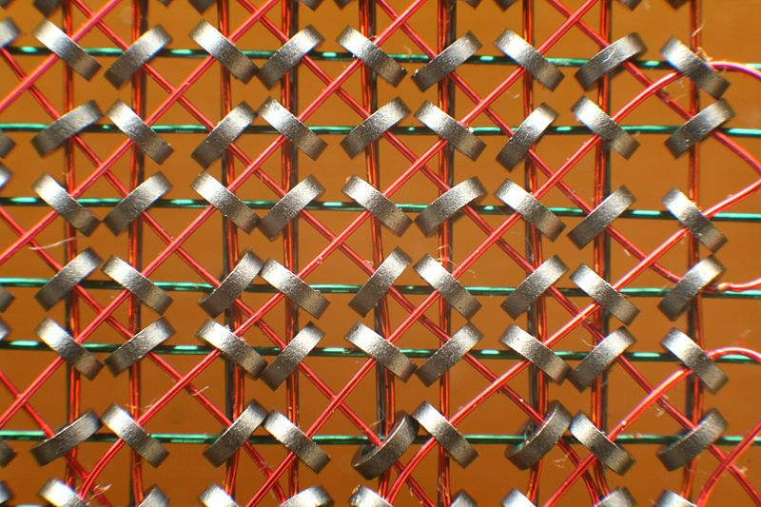
Semiconductor Main Memory
Early computers used doughnut shaped ferromagnetic loops – called cores
Modern computers use semiconductor memory

Slide 18
Memory Cell
Basic element of semiconductor memory
Common properties:
  Two stable states (call them 0 and 1)
  Capable of being written into (at least once) to set the state
  Capable of being read to sense the state

Slide 19
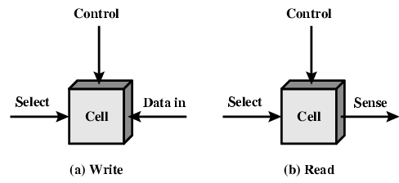
Memory Cell Operation

Slide 20
Semiconductor Memory Types
Memory Type | Category | Erasure | Write Mechanism | Volatility
Random-access memory (RAM) | Read-write memory | Electrically, byte-level | Electrically | Volatile
Read-only memory (ROM) | Read-only memory | Not possible | Masks | Nonvolatile
Programmable ROM (PROM) |  |  | Electrically
Erasable PROM (EPROM) | Read-mostly memory | UV light, chip-level
Electrically Erasable PROM (EEPROM) |  | Electrically, byte-level
Flash memory (used in memory cards, flash drives, etc.) |  | Electrically, block-level

Slide 21
Semiconductor Memory
RAM
  Misnamed as all semiconductor memory is random access
  Can read and write
  Volatile
  Used for temporary storage
  May be static or dynamic

Slide 22
Dynamic RAM
Bits stored as charge in capacitors
Charges leak
Need refreshing even when powered
Simpler construction
Smaller per bit
Less expensive
Need refresh circuits
Slower
Main memory
Essentially analog
  Level of charge determines value

Slide 23
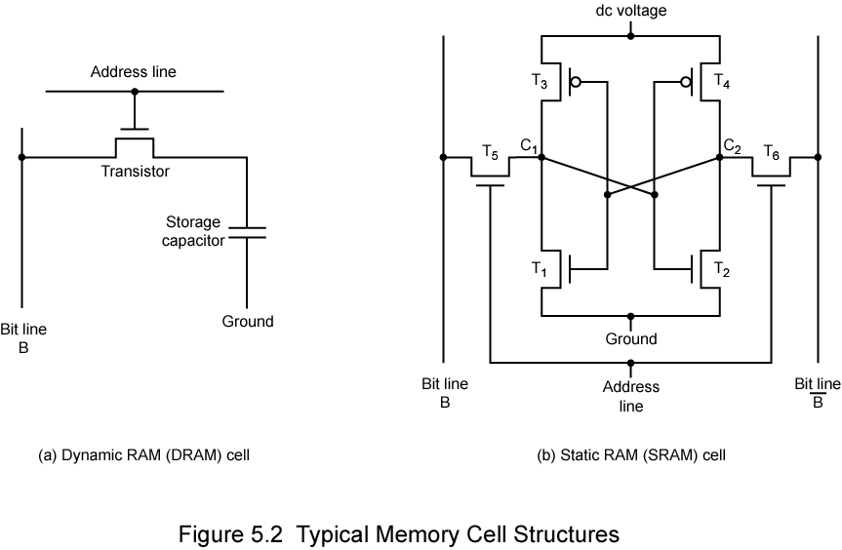
Dynamic RAM Structure

Slide 24
DRAM Operation
Address line active when bit read or written
  Transistor switch closed (current flows)
Write
  Voltage to bit line
    High for 1 low for 0
  Then signal address line
    Transfers charge to capacitor
Read
  Address line selected
    Transistor turns on
  Charge from capacitor fed via bit line to sense amplifier
    Compares with reference value to determine 0 or 1
  Capacitor charge must be restored
    Read is destructive

Slide 25
Static RAM
Bits stored as on/off switches
No charges to leak
No refreshing needed when powered
More complex construction
Larger per bit
More expensive
Does not need refresh circuits
Faster
Used in cache (both on and off chip)
Digital
  Uses flip-flops

Slide 26
Static RAM Structure

Slide 27
Static RAM Operation
Transistor arrangement gives stable logic state
State 1
  C₁ high, C₂ low
  T₁ T₄ off, T₂ T₃ on
State 0
  C₂ high, C₁ low
  T₂ T₃ off, T₁ T₄ on
Address line transistors T₅ T₆ is switch
Write – apply value to B & complement to B
Read – value is on line B

Slide 28
SRAM v DRAM
Both volatile
  Power needed to preserve data
Dynamic cell
  Simpler to build, smaller
  More dense (smaller cells = more cells per unit area)
  Less expensive
  Needs refresh
  Larger memory units (e.g., main memory)
Static
  Faster, but more expensive
  Cache

Slide 29
DRAM Refreshing
Refresh circuit included on chip
Disable chip
Count through rows
Read & Write back
Takes time
Slows down apparent performance

Slide 30
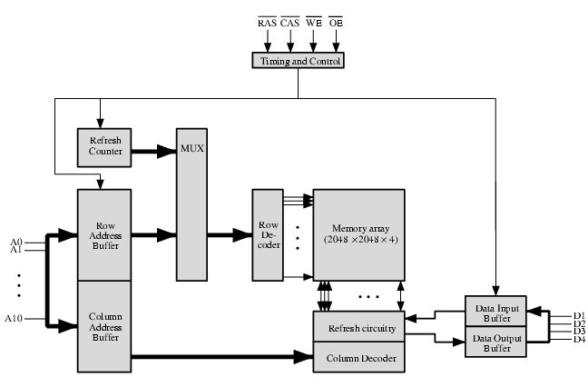
Typical 16 Mb DRAM (4M x 4)

Slide 31
Interleaved Memory
Memory chips can be grouped
  Memory bank
Each bank independently able to service read/write request
  System with K banks can service K requests simultaneously
If consecutive words of memory are stored in different banks, then transfer of that block of memory can be speeded up

Slide 32
Read Only Memory (ROM)
Permanent storage
  Nonvolatile
Microprogramming (see later)
Library subroutines
Systems programs (BIOS)
Function tables

Slide 33
Types of ROM
Written during manufacture
  Very expensive for small runs
Programmable (once)
  PROM
  Needs special equipment to program
Read “mostly”
  Erasable Programmable (EPROM)
    Erased by UV
  Electrically Erasable (EEPROM)
    Takes much longer to write than read
  Flash memory
    Erase whole memory electrically

Slide 34
Error Correction
Hard Failure
  Permanent defect
  Possible causes:
    Harsh environmental abuse
    Manufacturing defects
    Wear
Soft Error
  Random, non-destructive
  No permanent damage to memory
  Possible causes:
    Power supply problems
    Alpha particles
Detected using Hamming error correcting code

Slide 35
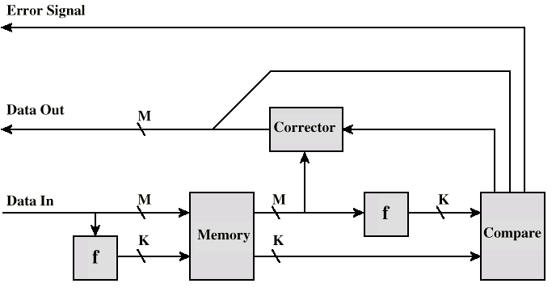
Error Correcting Code Function

Slide 36
Error Correction Process
Data written to memory
  Function performed on data
  Resulting code is stored along with data
Memory read
  Data is fetched
  New code set is produced and compared with stored set
  If same → no difference
  If different → error
  If error can be corrected, then all is well
  Otherwise, report memory error
    Possibly BSOD results

Slide 37
William Stallings
Computer Organization and Architecture
9th Edition
Chapter 4
Cache

Slide 38
So you want fast?
It is possible to build a computer which uses only static RAM (see later)
This would be very fast
This would need no cache
  How can you cache cache?
This would cost a very large amount
  Typical price is $0.60/MB ➔ $600/GB (if you could get it that large)

Slide 39
Locality of Reference
During the course of the execution of a program, memory references tend to cluster
  e.g. loops, operations on arrays
Clusters in use will vary with time
Would like to take advantage of this to minimize accesses to main memory

Slide 40
Cache
Small amount of fast memory
Sits between normal main memory and CPU
May be located on CPU chip or module

Slide 41
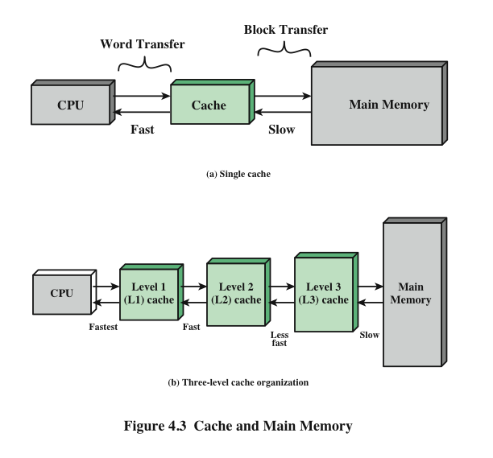
Cache and Main Memory

Slide 42
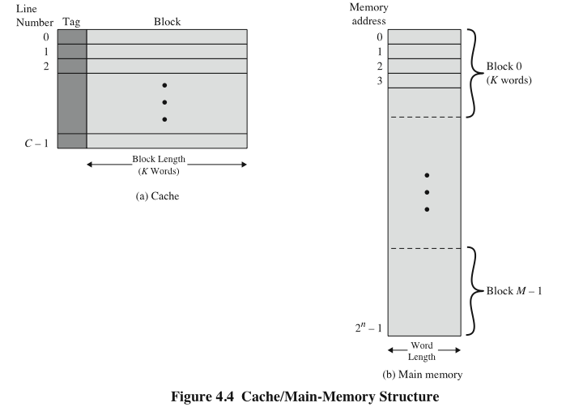
Cache/Main Memory Structure
Tag identifies which particular block of main memory is being stored
- Usually part of address

Slide 43
Cache operation – overview
CPU requests contents of memory location
Check cache for this data
If present, get from cache (fast)
If not present, read required block from main memory to cache
Then deliver from cache to CPU
Cache includes tags to identify which block of main memory is in each cache slot

Slide 44
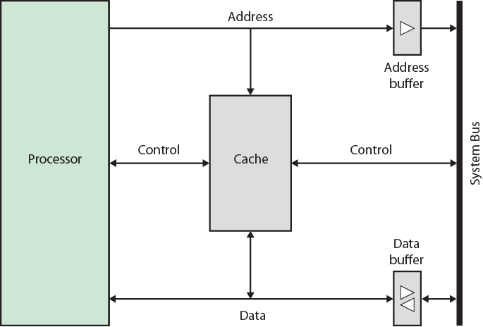
Typical Cache Organization

Slide 45
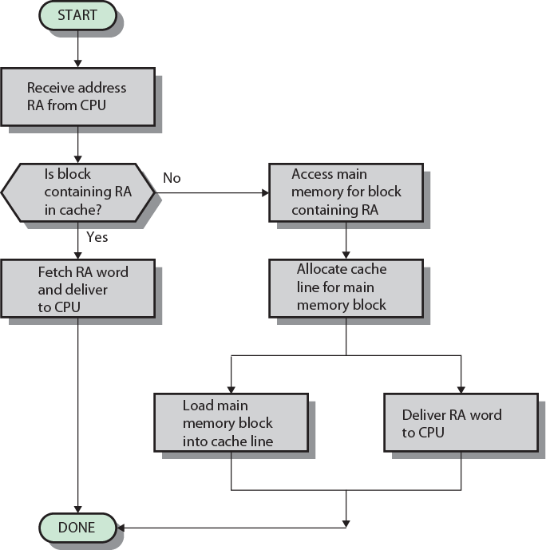
Cache Read Operation - Flowchart
RA = read address

Slide 46
Elements of Cache Design
Addressing
Size
Mapping Function
Replacement Algorithm
Write Policy
Line Size
Number of Caches

Slide 47
Cache Addressing
Where does cache sit?
  Between processor and virtual memory management unit
  Between MMU and main memory
Logical cache (virtual cache) stores data using virtual addresses
  Processor accesses cache directly, not through physical cache
  Cache access faster, before MMU address translation
  Virtual addresses use same address space for different applications
    Must flush cache on each context switch
Physical cache stores data using main memory physical addresses

Slide 48
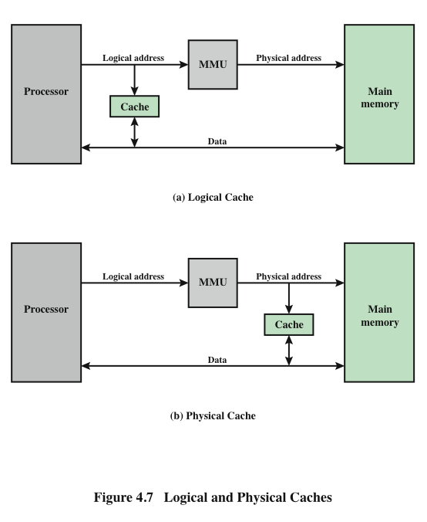
Logical and Physical Caches

Slide 49
Size does matter
Cost
  More cache is expensive
Speed
  More cache is faster (up to a point)
  Checking cache for data takes time

Slide 50
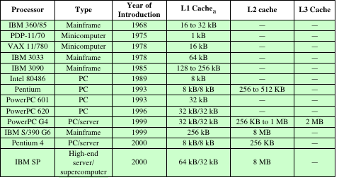
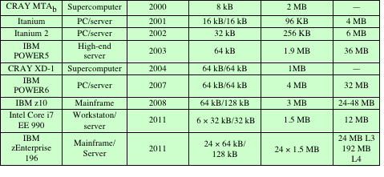
Cache Sizes of Some CPUs

Slide 51
Mapping Function
Cache is MUCH smaller than main memory
  Need to map main memory blocks into cache lines
Three techniques
  Direct
  Associative
  Set Associative

Slide 52
Mapping Function
Use this information in the following
Cache of 64 kByte
Cache block of 4 bytes
  i.e. cache is 16k (2¹⁴) lines of 4 bytes
16 MBytes main memory
24 bit address
  (2²⁴=16 M)

Slide 53
Direct Mapping
Each block of main memory maps to only one cache line
  i.e. if a block is in cache, it must be in one specific place
Address is in three parts
  Least significant bits specify the offset
    The offset tells where to find the desired byte in the line
  Middle bits specify the line or slot
  Most significant bits are for the tag
    The tag uniquely identifies a block of memory

Slide 54
Direct Mapping
Address Structure
Tag
Line or Slot
Offset
8
14
2
24 bit address broken up as follows
2 bit offset (4 byte block)
14 bit slot or line (2^14 lines)
8 bit tag (= 24-14-2)
No two blocks in the same line have the same Tag field
Check contents of cache by finding line and checking Tag

Slide 55
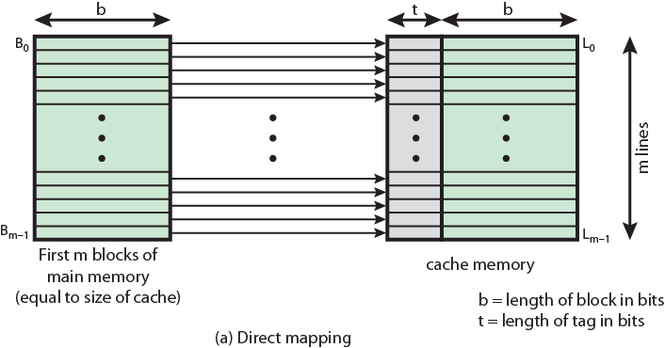
Direct Mapping from Cache to Main Memory

Slide 56
Direct Mapping
Cache Line Table
Cache line | Main Memory blocks held
0 | 0, m, 2m, 3m…2s-m
1 | 1,m+1, 2m+1…2s-m+1
…
m-1 | m-1, 2m-1,3m-1…2s-1

Slide 57
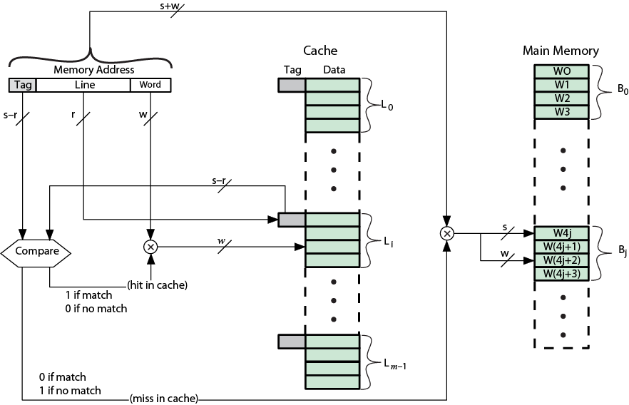
Direct Mapping Cache Organization

Slide 58
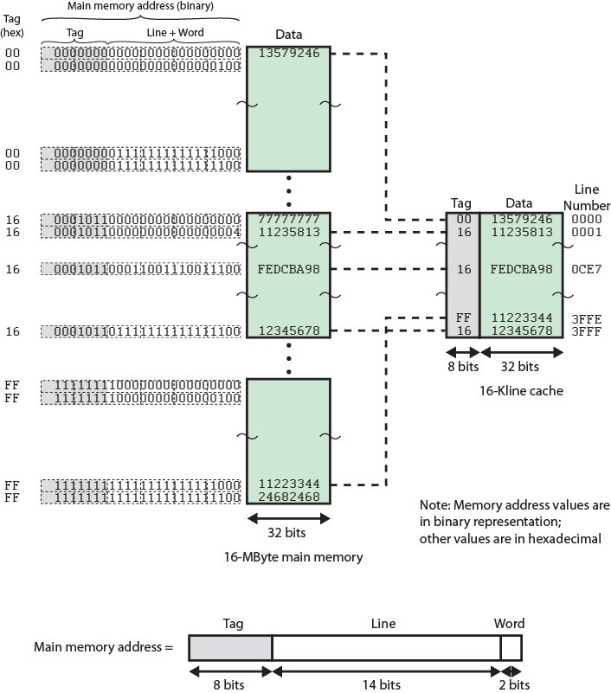
Direct
Mapping
Example

Slide 59
Direct Mapping pros & cons
Simple
Inexpensive
Fixed location for given block
  If a program accesses 2 blocks that map to the same line repeatedly, cache misses are very high
  Victim cache tries to resolve this

Slide 60
Victim Cache
Lower miss penalty
Remember what was discarded
  Already fetched
  Use again with little penalty
Fully associative
4 to 16 cache lines
Between direct mapped L1 cache and next memory level

Slide 61
Associative Mapping
A main memory block can load into any line of cache
Memory address is interpreted as tag and word
Tag uniquely identifies block of memory
Every line’s tag is examined for a match
Cache searching gets expensive

Slide 62
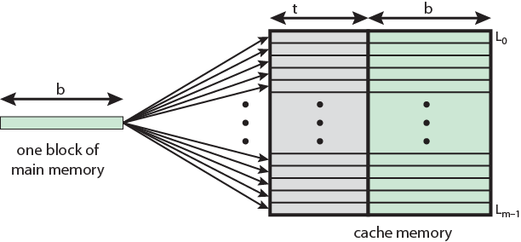
Associative Mapping from
Cache to Main Memory

Slide 63
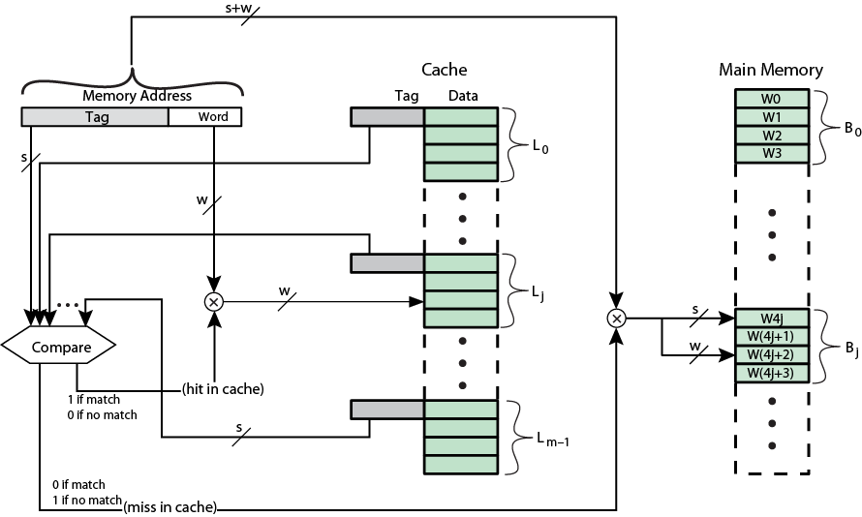
Fully Associative Cache Organization

Slide 64
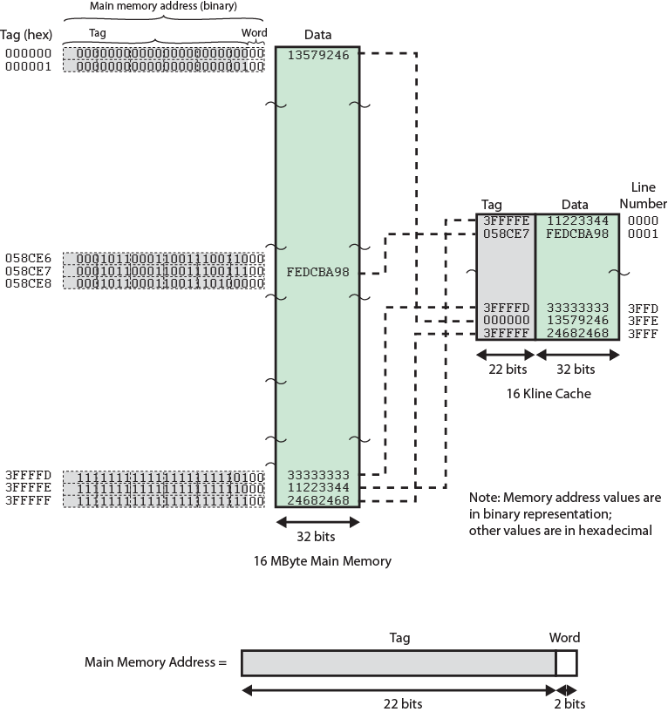
Associative
Mapping
Example

Slide 65
Associative Mapping
Address Structure
Offset
2 bit
Tag 22 bit
22 bit tag stored with each 4 byte block of data
Compare tag field with tag entry in cache to check for hit
Least significant 2 bits of address identify which byte is required from 4 byte data block
e.g.
  Address Tag Data Cache line
  FFFFFC 3FFFF 24682468 3FFF

Slide 66
Set Associative Mapping
Compromise exhibiting strengths of both direct and associative, while reducing their disadvantages
Cache is divided into a number of sets
Each set contains a number of lines
A given block maps to any line in a given set
  e.g. Block B can be in any line of set i
e.g. 2 lines per set
  2 way associative mapping
  A given block can be in one of 2 lines in only one set

Slide 67
Set Associative Mapping
Example
13 bit set number
  (2^14 lines/2 lines per set = 2^13)
Block number in main memory is modulo 2¹³
000000, 00A000, 00B000, 00C000 … map to same set

Slide 68
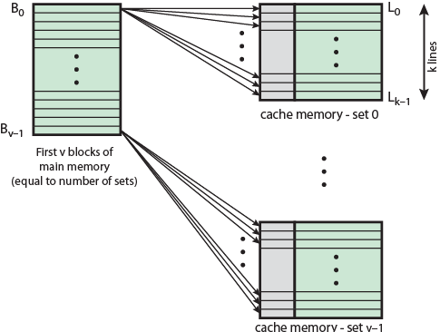
Mapping From Main Memory to Cache: v Associative

Slide 69
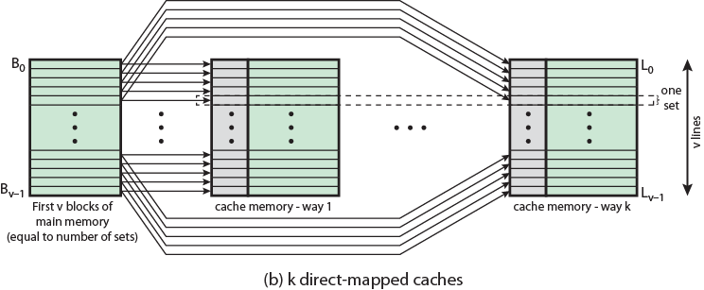
Mapping From Main Memory to Cache: k-way Associative

Slide 70
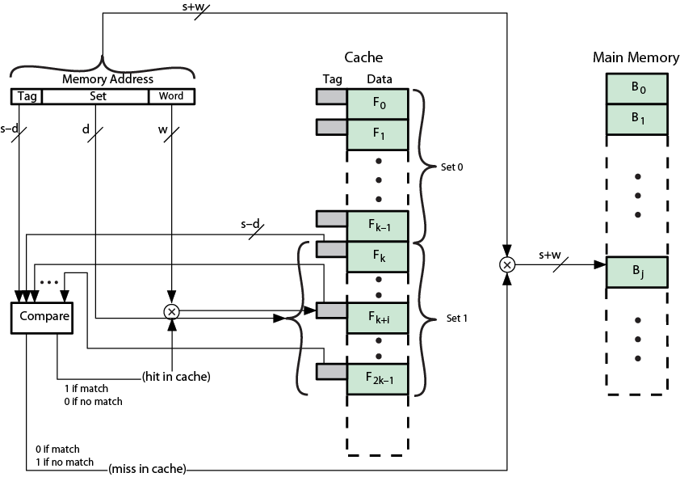
K-Way Set Associative Cache Organization

Slide 71
Set Associative Mapping
Address Structure
Offset
2 bit
Tag 9 bit
Set 13 bit
Use set field to determine cache set to look in
Compare tag field to see if we have a hit
e.g
  Address Tag Data Set number
  1FF 7FFC 1FF 12345678 1FFF
  001 7FFC 001 11223344 1FFF

Slide 72
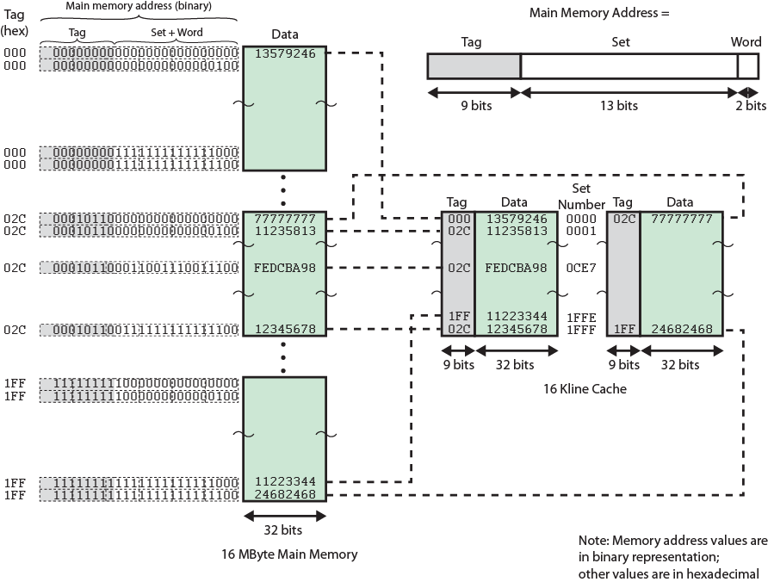
Two Way Set Associative Mapping Example

Slide 73
Direct and Set Associative Cache
Performance Differences
Significant up to at least 64kB for 2-way
Difference between 2-way and 4-way at 4kB much less than 4kB to 8kB
Cache complexity increases with associativity
Not justified against increasing cache to 8kB or 16kB
Above 32kB gives no improvement

Slide 74
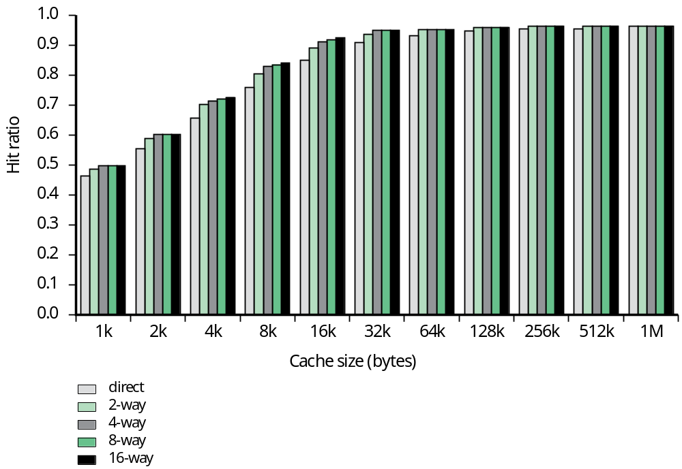
Figure 4.16
Varying Associativity over Cache Size

Slide 75
Replacement Algorithms
What happens when cache is filled and a new block must be brought in?

Slide 76
Replacement Algorithms (1)
Direct mapping
No choice
Each block only maps to one line
Replace that line

Slide 77
Replacement Algorithms (2)
Associative & Set Associative
Usually hardware implemented algorithm (speed)
Least Recently used (LRU)
  e.g. in 2 way set associative
  Which of the 2 blocks is lru?
First in first out (FIFO)
  replace block that has been in cache longest
Least frequently used (LFU)
  replace block which has had fewest hits
Random

Slide 78
Write Policy
Must not overwrite a cache block unless main memory is up to date
Multiple CPUs may have individual caches
I/O may address main memory directly

Slide 79
Write through
All writes go to main memory as well as cache
Multiple CPUs can monitor main memory traffic to keep local (to CPU) cache up to date
Lots of traffic
Slows down writes

Slide 80
Write back
Updates initially made in cache only
Update bit for cache slot is set when update occurs
If block is to be replaced, write to main memory only if update bit is set
Other caches get out of sync
I/O must access main memory through cache
N.B. 15% of memory references are writes

Slide 81
Line Size
Retrieve not only desired word but a number of adjacent words as well
Increased block size will increase hit ratio at first
  the principle of locality
Hit ratio will decreases as block becomes even bigger
  Probability of using newly fetched information becomes less than probability of reusing replaced
Larger blocks
  Reduce number of blocks that fit in cache
  Data overwritten shortly after being fetched
  Each additional word is less local so less likely to be needed
No definitive optimum value has been found
8 to 64 bytes seems reasonable
For HPC systems, 64- and 128-byte most common

Slide 82
Multilevel Caches
High logic density enables caches on chip
  Faster than bus access
  Frees bus for other transfers
Common to use both on and off chip cache
  L1 on chip, L2 off chip in static RAM
  L2 access much faster than DRAM or ROM
  L2 often uses separate data path
  L2 may now be on chip
  Resulting in L3 cache

Slide 83
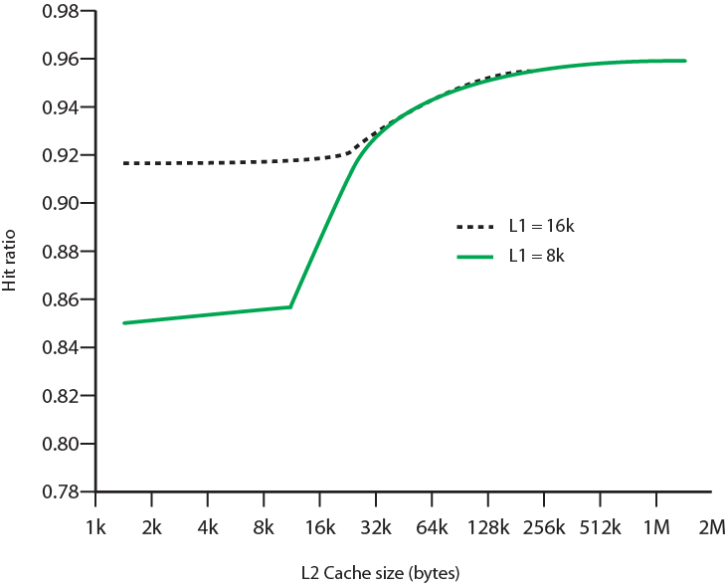
Hit Ratio (L1 & L2)
For 8 kbytes and 16 kbyte L1

Slide 84
Unified v Split Caches
One cache for data and instructions or two, one for data and one for instructions
Advantages of unified cache
  Higher hit rate
    Balances load of instruction and data fetch
    Only one cache to design & implement
Advantages of split cache
  Eliminates cache contention between instruction fetch/decode unit and execution unit
    Important in pipelining
Trend is toward split caches for L1 and unified for higher levels

Slide 85
Pentium 4 Cache
80386 – no on chip cache
80486 – 8k using 16 byte lines and four way set associative organization
Pentium (all versions) – two on chip L1 caches
  Data & instructions
Pentium III – L3 cache added off chip
Pentium 4
  L1 caches
    8k bytes
    64 byte lines
    four way set associative
  L2 cache
    Feeding both L1 caches
    256k
    128 byte lines
    8 way set associative
  L3 cache on chip

Slide 86
Intel Cache Evolution
Problem
Solution
Processor on which feature first appears
External memory slower than the system bus.
Add external cache using faster memory technology.
386
Increased processor speed results in external bus becoming a bottleneck for cache access.
Move external cache on-chip, operating at the same speed as the processor.
486
Internal cache is rather small, due to limited space on chip
Add external L2 cache using faster technology than main memory
486
Contention occurs when both the Instruction Prefetcher and the Execution Unit simultaneously require access to the cache. In that case, the Prefetcher is stalled while the Execution Unit’s data access takes place.
Create separate data and instruction caches.
Pentium
Increased processor speed results in external bus becoming a bottleneck for L2 cache access.
Create separate back-side bus that runs at higher speed than the main (front-side) external bus. The BSB is dedicated to the L2 cache.
Pentium Pro
Move L2 cache on to the processor chip.
Pentium II
Some applications deal with massive databases and must have rapid access to large amounts of data. The on-chip caches are too small.
Add external L3 cache.
Pentium III
Move L3 cache on-chip.
Pentium 4

Slide 87
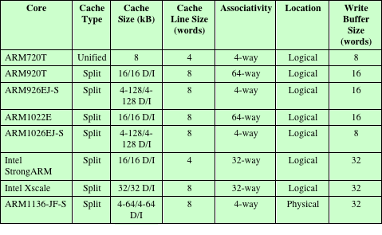
ARM Cache Evolution

Slide 88
William Stallings
Computer Organization and Architecture
9th Edition
Chapter 6
External Memory

Slide 89
Types of External Memory
Magnetic Disk
  RAID
  Removable
Optical
  CD-ROM
  CD-Recordable (CD-R)
  CD-R/W
  DVD
Magnetic Tape
Solid State devices

Slide 90
Magnetic Disk
Circular platter constructed of nonmagnetic material, called substrate, coated with magnetizable material (iron oxide…rust)
Substrate used to be aluminium
Now glass
  Improved surface uniformity
    Increases reliability
  Reduction in surface defects
    Reduced read/write errors
  Lower flight heights (See later)
  Better stiffness
  Better shock/damage resistance

Slide 91
Read and Write Mechanisms
Recording & retrieval via conductive coil called a head
May be single read/write head or separate ones
During read/write, head is stationary, platter rotates
Write
  Current through coil produces magnetic field
  Pulses sent to head
  Magnetic pattern recorded on surface below
Read (traditional)
  Magnetic field moving relative to coil produces current
  Coil is the same for read and write
Read (contemporary)
  Separate read head, close to write head
  Partially shielded magneto resistive (MR) sensor
  Electrical resistance depends on direction of magnetic field
  High frequency operation
    Higher storage density and speed

Slide 92
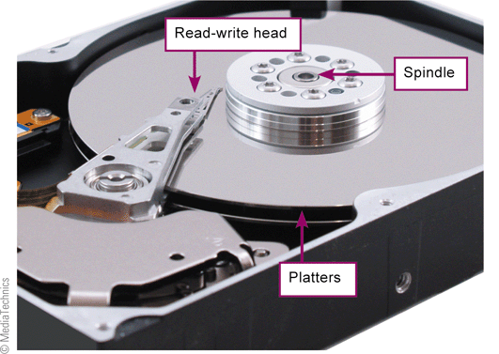
Typical Hard Drive

Slide 93
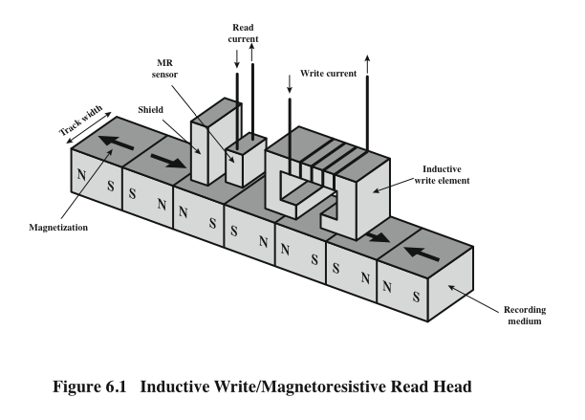
Inductive Write MR Read

Slide 94
Data Organization and Formatting
Concentric rings or tracks
  Gaps between tracks
  Reduce gap to increase capacity
  Same number of bits per track (variable packing density)
  Constant angular velocity
Tracks divided into sectors
Minimum block size is one sector
May have more than one sector per block

Slide 95
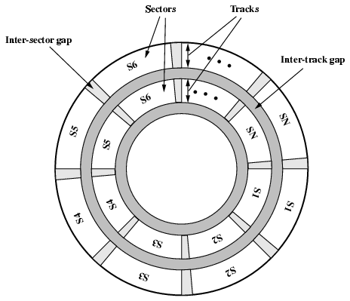
Disk Data Layout

Slide 96
Disk Velocity
Bit near center of rotating disk passes fixed point slower than bit on outside of disk
Increase spacing between bits in different tracks
Rotate disk at constant angular velocity (CAV)
  Gives pie shaped sectors and concentric tracks
  Individual tracks and sectors addressable
  Move head to given track and wait for given sector
  Waste of space on outer tracks
    Lower data density
Can use zones to increase capacity
  Each zone has fixed bits per track
  More complex circuitry

Slide 97
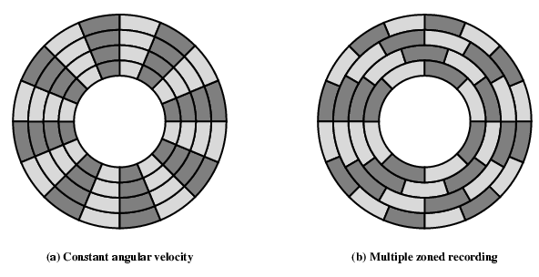
Disk Layout Methods Diagram

Slide 98
Finding Sectors
Must be able to identify start of track and sector
Format disk
  Additional information not available to user
  Marks tracks and sectors

Slide 99
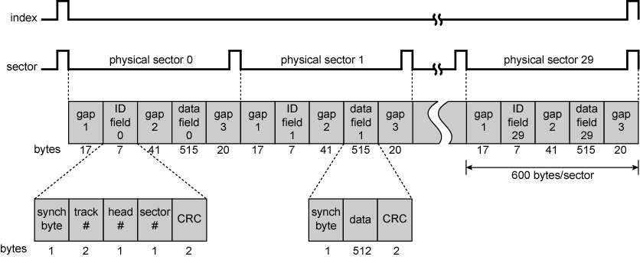
Winchester Disk Format
Seagate ST506

Slide 100
Characteristics
Fixed (rare) or movable head
Removable or fixed
Single or double (usually) sided
Single or multiple platter
Head mechanism
  Contact (Floppy)
  Fixed gap
  Flying (Winchester)

Slide 101
Fixed/Movable Head Disk
Fixed head
  One read write head per track
  Heads mounted on fixed rigid arm
Movable head
  One read/write head per side
  Mounted on a movable arm

Slide 102
Multiple Platter
One head per side
Heads are joined and aligned
Aligned tracks on each platter form cylinders
Data is striped by cylinder
  reduces head movement
  Increases speed (transfer rate)

Slide 103
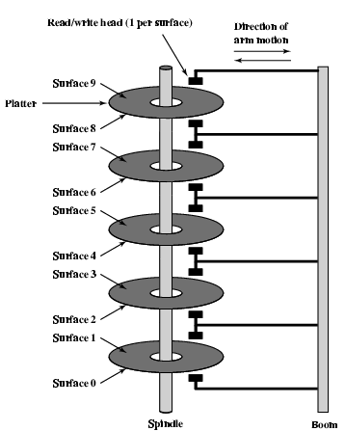
Multiple Platters

Slide 104
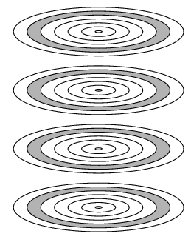
Tracks and Cylinders

Slide 105
Speed
Seek time
  Moving head to correct track
(Rotational) latency
  Waiting for data to rotate under head
Access time = Seek + Latency
Transfer rate

Slide 106
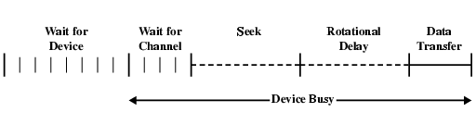
Timing of Disk I/O Transfer

Slide 107
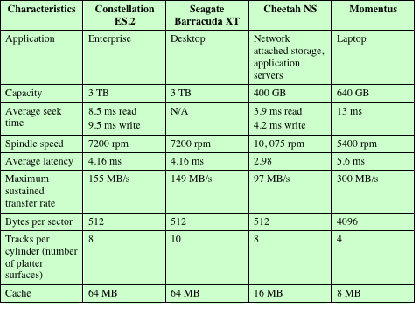
Typical Hard Disk Parameters

Slide 108
RAID
Redundant Array of Independent Disks
  Redundant Array of Inexpensive Disks
6 levels in common use
Not a hierarchy
Set of physical disks viewed as single logical drive by O/S
Data distributed across physical drives
Can use redundant capacity to store parity information

Slide 109
RAID 0
No redundancy
Data striped across all disks
Round Robin striping
Increase speed
  Multiple data requests probably not on same disk
  Disks seek in parallel
  A set of data is likely to be striped across multiple disks

Slide 110
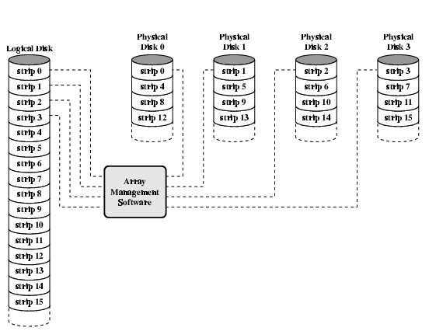
Data Mapping For RAID 0

Slide 111
RAID 1
Mirrored Disks
Data is striped across disks
2 copies of each stripe on separate disks
Read from either
Write to both
Recovery is simple
  Swap faulty disk & re-mirror
  No down time
Expensive

Slide 112
RAID 2
Disks are synchronized
Very small stripes
  Often single byte/word
Error correction calculated across corresponding bits on disks
Multiple parity disks store Hamming code error correction in corresponding positions
Lots of redundancy
  Expensive
  Not used

Slide 113
RAID 3
Similar to RAID 2
Only one redundant disk, no matter how large the array
Simple parity bit for each set of corresponding bits
Data on failed drive can be reconstructed from surviving data and parity info
Very high transfer rates

Slide 114
RAID 4
Each disk operates independently
Good for high I/O request rate
Large stripes
Bit by bit parity calculated across stripes on each disk
Parity stored on parity disk

Slide 115
RAID 5
Like RAID 4
Parity striped across all disks
Round robin allocation for parity stripe
Avoids RAID 4 bottleneck at parity disk
Commonly used in network servers

Slide 116
RAID 6
Two parity calculations
Stored in separate blocks on different disks
User requirement of N disks needs N+2
High data availability
  Three disks need to fail for data loss
  Significant write penalty

Slide 117
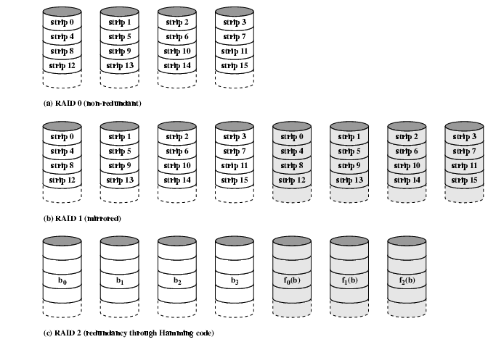
RAID 0, 1, 2

Slide 118
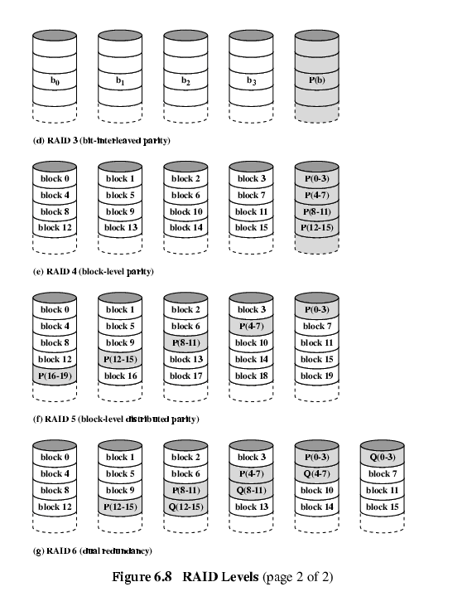
RAID 3 & 4

Slide 119
RAID 5 & 6

